Slide 1
Chapter 5
The Relational Data Model
Copyright © 2004 Pearson Education, Inc.

Slide 2
Outline
Relational Model Concepts
Relational Model Constraints and Relational Database Schemas
Update Operations and Dealing with Constraint Violations
Slide 2 -<number>

Slide 3
Relational Model Concepts
The relational Model of Data is based on the concept of a Relation.
A Relation is a mathematical concept based on the ideas of sets.
The strength of the relational approach to data management comes from the formal foundation provided by the theory of relations.
We review the essentials of the relational approach in this chapter.
Slide 2 -<number>

Slide 4
Relational Model Concepts
The model was first proposed by Dr. E.F. Codd of IBM in 1970 in the following paper:
"A Relational Model for Large Shared Data Banks," Communications of the ACM, June 1970.
The above paper caused a major revolution in the field of Database management and earned Ted Codd the coveted ACM Turing Award.
Slide 2 -<number>

Slide 5
INFORMAL DEFINITIONS
RELATION: A table of values
  A relation may be thought of as a set of rows.
  A relation may alternately be though of as a set of columns.
  Each row represents a fact that corresponds to a real-world entity or relationship.
  Each row has a value of an item or set of items that uniquely identifies that row in the table.
  Sometimes row-ids or sequential numbers are assigned to identify the rows in the table.
  Each column typically is called by its column name or column header or attribute name.
Slide 2 -<number>

Slide 6
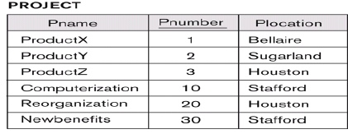

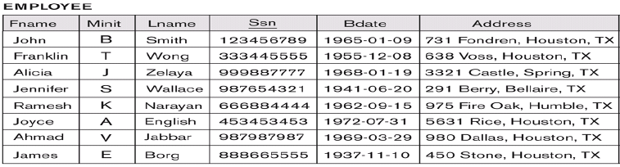
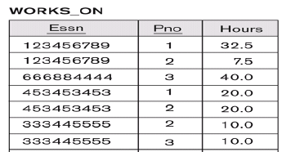
Slide 2 -<number>

Slide 7
FORMAL DEFINITIONS
A Relation may be defined in multiple ways.
The Schema of a Relation: R (A1, A2, .....An)
Relation schema R is defined over attributes A1, A2, .....An
A relation (or relation state) r = {t1, t2, t3, .., tm} (m tuples)
Exp: CUSTOMER (Cust-id, Cust-name, Address, Phone#)
Slide 2 -<number>

Slide 8
FORMAL DEFINITIONS
A tuple t is an ordered set of values
t = <v1, v2, …, vn> (n values)
Each value is derived from an appropriate domain.
v_{i} is a element of dom(Ai) or Null value
Exp: <632895, "John Smith", "101 Main St. Atlanta, GA 30332", "(404) 894-2000">
is a tuple belonging to the CUSTOMER relation.
A relation may be regarded as a set of tuples (rows).
Columns in a table are also called attributes of the relation.
Slide 2 -<number>

Slide 9
FORMAL DEFINITIONS
A domain has a logical definition: e.g.,
“USA_phone_numbers” are the set of 10 digit phone numbers valid in the U.S.
A domain may have a data-type or a format defined for it. The USA_phone_numbers may have a format: (ddd)-ddd-dddd where each d is a decimal digit. E.g., Dates have various formats such as monthname, date, year or yyyy-mm-dd, or dd mm,yyyy etc.
An attribute designates the role played by the domain. E.g., the domain Date may be used to define attributes “Invoice-date” and “Payment-date”.
Slide 2 -<number>

Slide 10
FORMAL DEFINITIONS
The relation is formed over the cartesian product of the sets; each set has values from a domain; that domain is used in a specific role which is conveyed by the attribute name.
For example, attribute Cust-name is defined over the domain of strings of 25 characters. The role these strings play in the CUSTOMER relation is that of the name of customers.
Formally,
Given R(A₁, A₂, .........., A_{n})
  r(R) ⊂ dom (A₁) X dom (A₂) X ....X dom(A_{n})
R: schema of the relation
r of R: a specific state or population of R.
R is also called the intension of a relation
r is also called the extension of a relation
Slide 2 -<number>

Slide 11
FORMAL DEFINITIONS
Let S1 = {0,1}
Let S2 = {a,b,c}
Let R ⊂ S1 X S2
Then for example: r(R) = {<0,a> , <0,b> , <1,c> }
is one possible “state” or “population” or “extension” r of the relation R, defined over domains S1 and S2. It has three tuples.
Slide 2 -<number>

Slide 12
DEFINITION SUMMARY
Informal Terms |  | Formal Terms
Table |  | Relation
Column |  | Attribute/Domain
Row |  | Tuple
Values in a column |  | Domain
Table Definition |  | Schema of a Relation
Populated Table |  | Extension
Chapter 2 <number>

Slide 13
A relation schema R, denoted by R(A1, A2, … , An), is made up of a relation name
R and a list of attributes, A1, A2, … , An. Each attribute Ai is the name of a role played by some domain D in the relation schema R. D is called the domain of Ai and is denoted by dom(Ai). A relation schema is used to describe a relation; R is called the name of this relation. The degree (or arity) of a relation is the number of attributes n of its relation schema.
Chapter 2 <number>

Slide 14
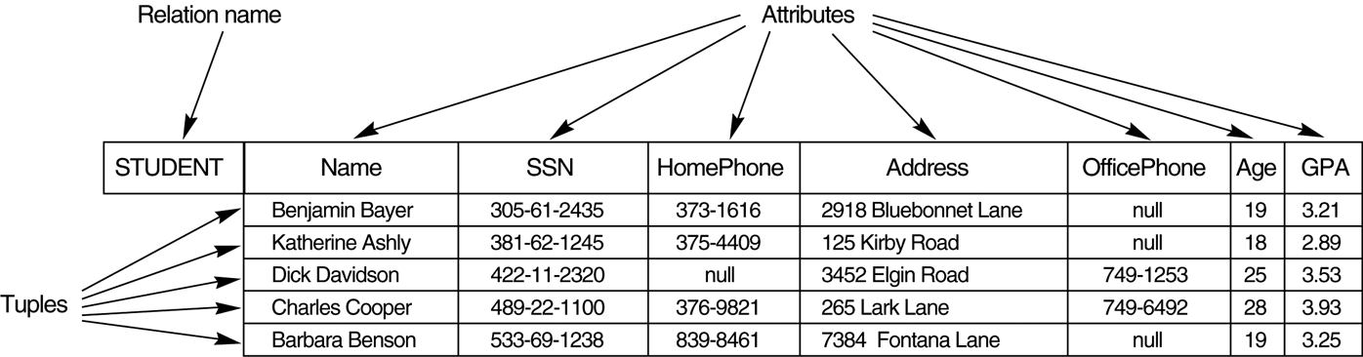
Example
Slide 2-<number>

Slide 15
CHARACTERISTICS OF RELATIONS
Ordering of tuples in a relation r(R): The tuples are not considered to be ordered, even though they appear to be in the tabular form.
Ordering of attributes in a relation schema R (and of values within each tuple): We will consider the attributes in R(A₁, A₂, ..., A_{n}) and the values in t=<v₁, v₂, ..., v_{n}> to be ordered .
Values in a tuple: All values are considered atomic (indivisible). A special null value is used to represent values that are unknown or inapplicable to certain tuple.
Slide 2 -<number>

Slide 16
Relational Model Notation
A relation schema R of degree n is denoted by R(A1, A2, … , An).
The uppercase letters Q, R, S denote relation names.
■ The lowercase letters q, r, s denote relation states.
■ The letters t, u, v denote tuples.
■ In general, the name of a relation schema such as STUDENT also indicates the current set of tuples in that relation—the current relation state—whereas STUDENT(Name, Ssn, …) refers only to the relation schema.
An attribute A can be qualified with the relation name R to which it belongs by using the dot notation R.A—for example, STUDENT.Name or STUDENT.Age. This is because the same name may be used for two attributes in different relations. However, all attribute names in a particular relation must be distinct.
Slide 2 -<number>

Slide 17
An n-tuple t in a relation r(R) is denoted by t = <v1, v2, … , vn>, where vi is
the value corresponding to attribute Ai. The following notation refers to
component values of tuples:
Both t[Ai] and t.Ai (and sometimes t[i]) refer to the value vi in t for attribute
Ai.
Both t[Au, Aw, … , Az] and t.(Au, Aw, … , Az), where Au, Aw, … , Az is a list
of attributes from R, refer to the subtuple of values <vu, vw, … , vz> from t
corresponding to the attributes specified in the list.
As an example, consider the tuple t = <’Barbara Benson’, ‘533-69-1238’,
‘(817)839-8461’, ‘7384 Fontana Lane’, NULL, 19, 3.25> from the STUDENT relation in Figure
5.1; we have t[Name] = <‘Barbara Benson’>, and t[Ssn, Gpa, Age] = <‘533-69-1238’,3.25, 19>.
Slide 2 -<number>

Slide 18
CHARACTERISTICS OF RELATIONS
Notation:
- We refer to component values of a tuple t by t[A_{i}] = v_{i} (the value of attribute A_{i} for tuple t).
Similarly, t[A_{u}, A_{v}, ..., A_{w}] refers to the subtuple of t containing the values of attributes A_{u}, A_{v}, ..., A_{w}, respectively.
Slide 2 -<number>

Slide 19
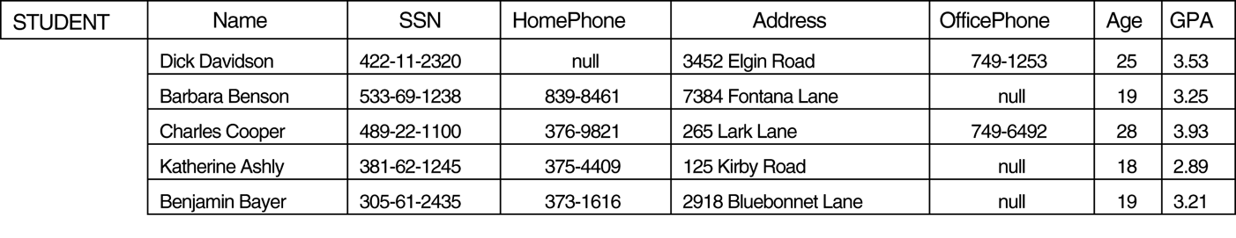
CHARACTERISTICS OF RELATIONS
t2[Name] = “Barbara Benson”
t2[Name, SSN] = “Barbara Benson”, 533-69-1238
Slide 2-<number>

Slide 20
Relational Integrity Constraints
(Schema –based contraints)
Constraints are conditions that must hold on all valid relation instances. There are three main types of constraints:
  Domain contraints
  Key constraints
  Entity integrity constraints
  Referential integrity constraints
Slide 2 -<number>

Slide 21
Domain contraints
Attributes have specific values in real-world scenario.
For example, age can only be a positive integer. The same constraints have been tried to employ on the attributes of a relation.
Every attribute is bound to have a specific range of values. For example, age cannot be less than zero and telephone numbers cannot contain a digit outside 0-9.
Slide 2 -<number>

Slide 22
KEY CONSTRAINT
Key Constraints There must be at least one minimal subset of attributes in the relation, which can identify a tuple uniquely. This minimal subset of attributes is called key for that relation.
If there are more than one such minimal subsets, these are called candidate keys.
Key constraints force that − in a relation with a key attribute, no two tuples can have identical values for key attributes.
A key attribute can not have NULL values. Key constraints are also referred to as Entity Constraints.
Slide 2 -<number>

Slide 23
Key Constraints
Superkey of R: A set of attributes SK of R such that no two tuples in any valid relation instance r(R) will have the same value for SK. That is, for any distinct tuples t1 and t2 in r(R), t1[SK] ≠ t2[SK].
Key of R: A "minimal" superkey; that is, a superkey K such that removal of any attribute from K results in a set of attributes that is not a superkey.
  Example: The CAR relation schema:
  CAR(State, Reg#, SerialNo, Make, Model, Year)
  has two keys Key1 = {State, Reg#}, Key2 = {SerialNo}, which are also superkeys. {SerialNo, Make} is a superkey.
If a relation has several candidate keys, one is chosen arbitrarily to be the primary key. The primary key attributes are underlined.
Slide 2 -<number>

Slide 24
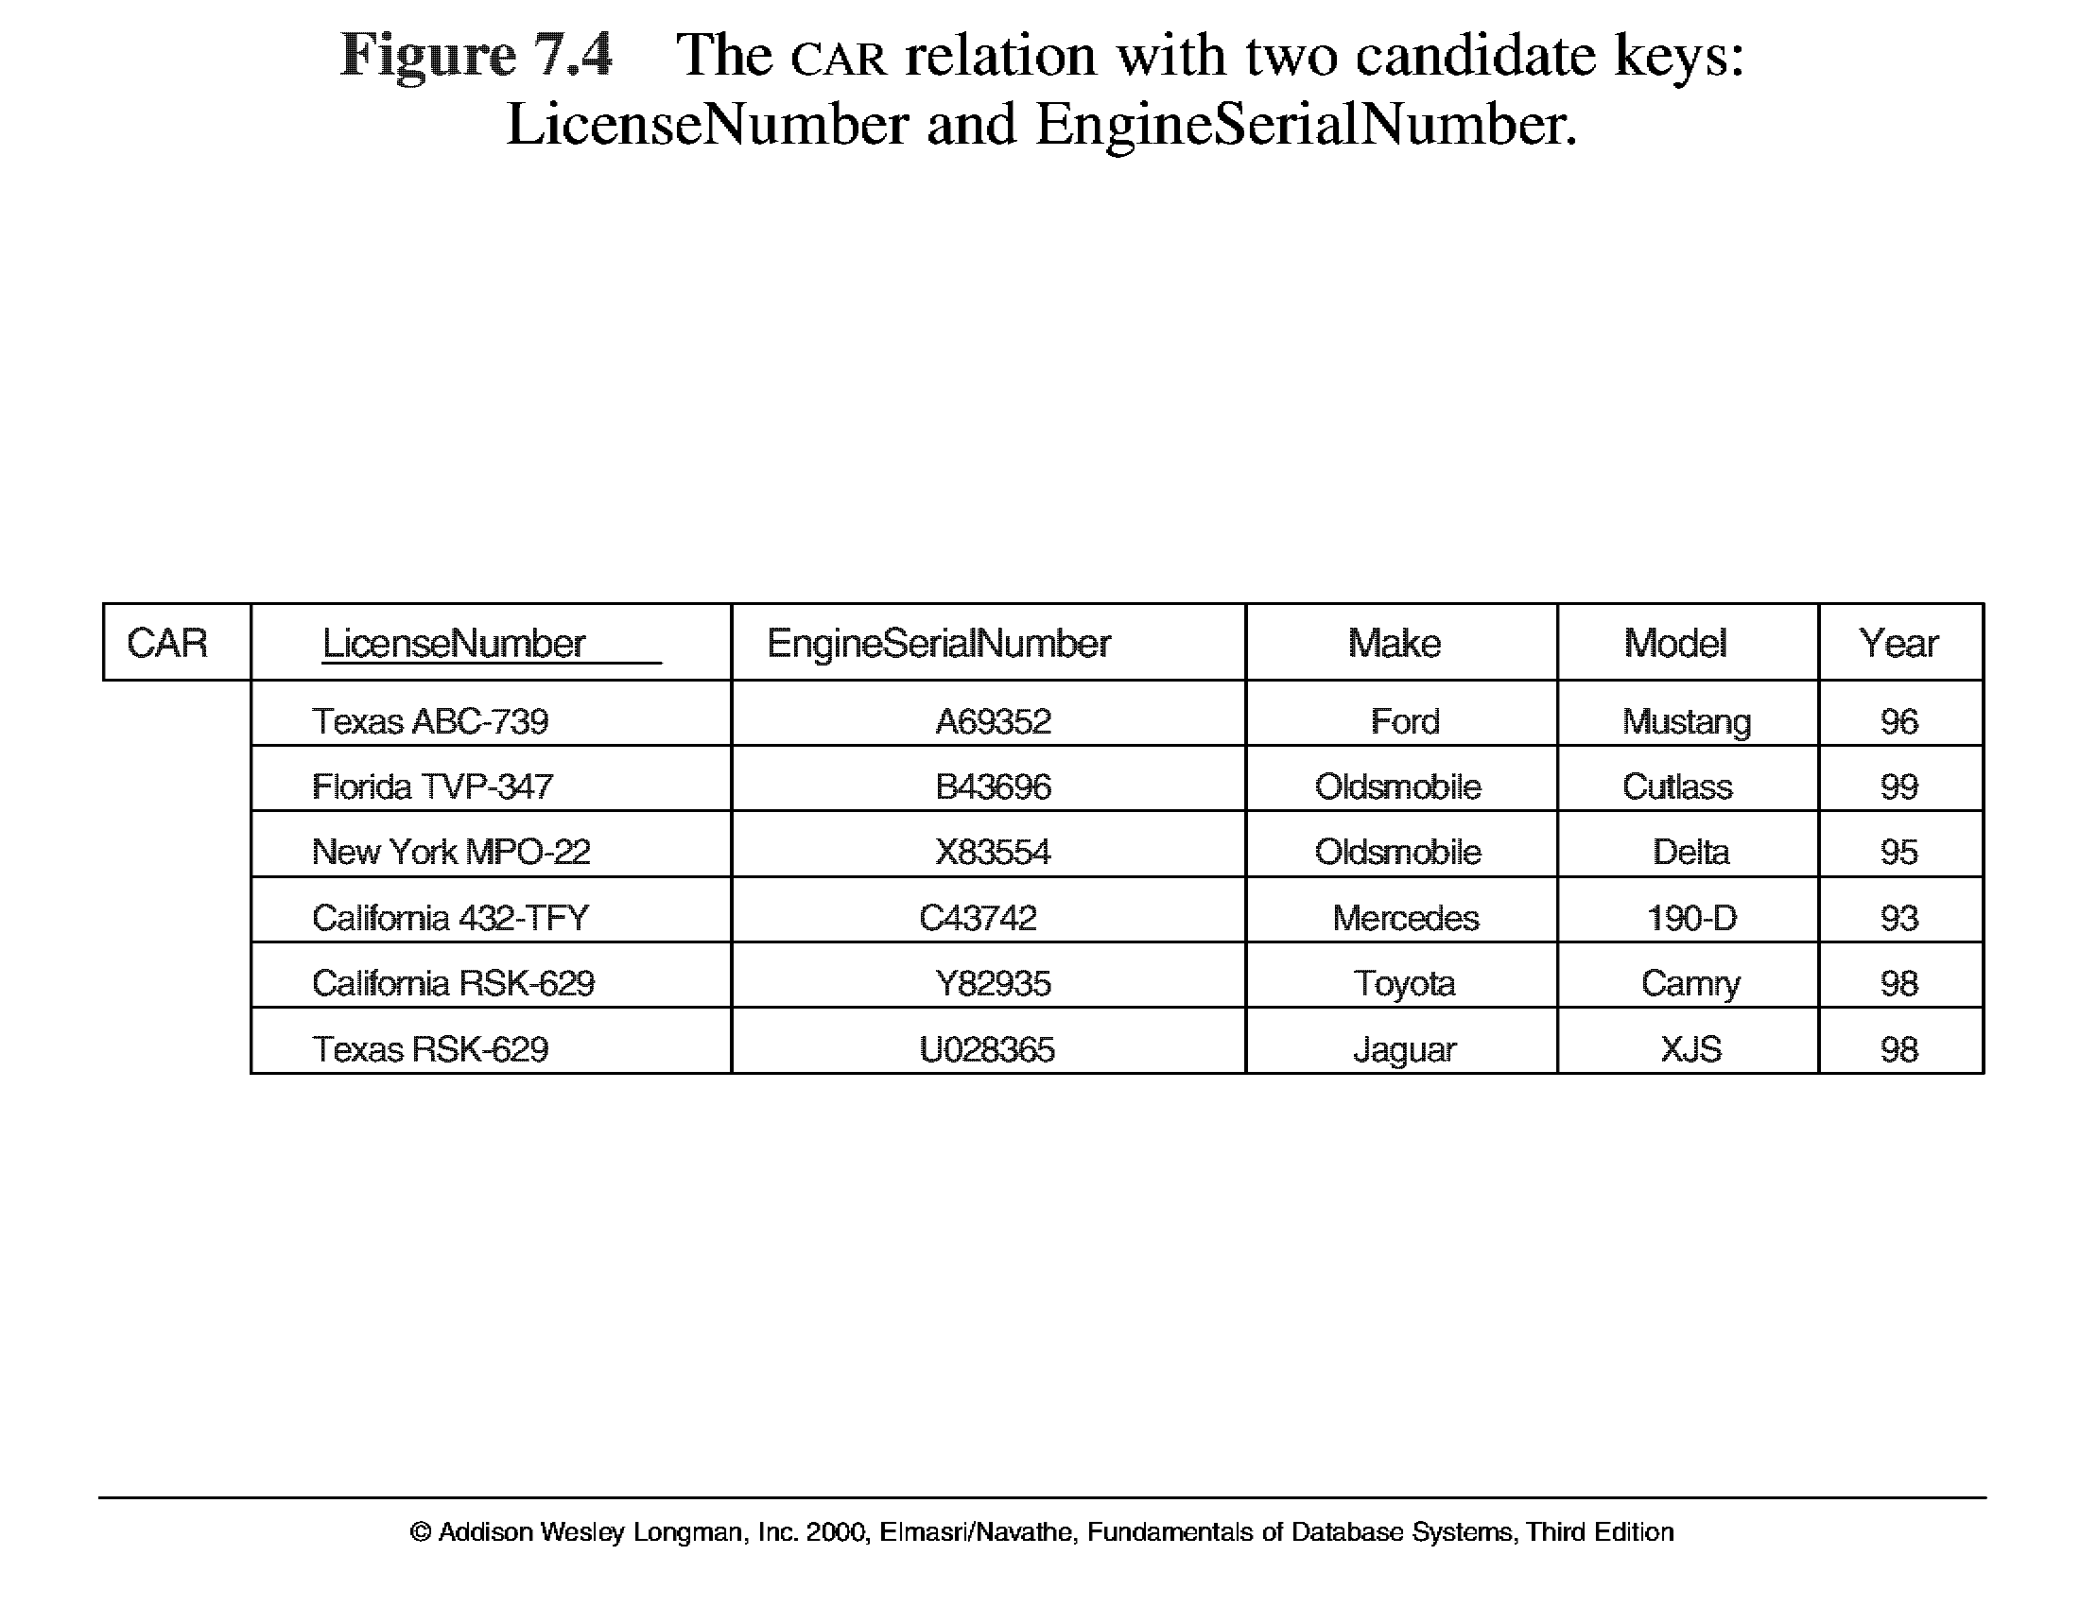
Key Constraints
Slide 2 -<number>

Slide 25
Entity Integrity Contraints
Relational Database Schema: A set S of relation schemas that belong to the same database. S is the name of the database.
S = {R₁, R₂, ..., R_{n}}
Entity Integrity: The primary key attributes PK of each relation schema R in S cannot have null values in any tuple of r(R). This is because primary key values are used to identify the individual tuples.
t[PK] ≠ null for any tuple t in r(R)
Note: Other attributes of R may be similarly constrained to disallow null values, even though they are not members of the primary key.
Slide 2 -<number>

Slide 26
Referential Integrity Constraints
A constraint involving two relations (the previous constraints involve a single relation).
Used to specify a relationship among tuples in two relations: the referencing relation and the referenced relation.
Tuples in the referencing relation R₁ have attributes FK (called foreign key attributes) that reference the primary key attributes PK of the referenced relation R₂. A tuple t₁ in R₁ is said to reference a tuple t₂ in R₂ if t₁[FK] = t₂[PK].
Referential integrity constraints arise from the relationships among the entities
A referential integrity constraint can be displayed in a relational database schema as a directed arc from R₁.FK to R₂.
Slide 2 -<number>

Slide 27
Referential integrity constraints work on the concept of Foreign Keys. A foreign key is a key attribute of a relation that can be referred in other relation.
Referential integrity constraint states that if a relation refers to a key attribute of a different or same relation, then that key element must exist.
Slide 2 -<number>

Slide 28
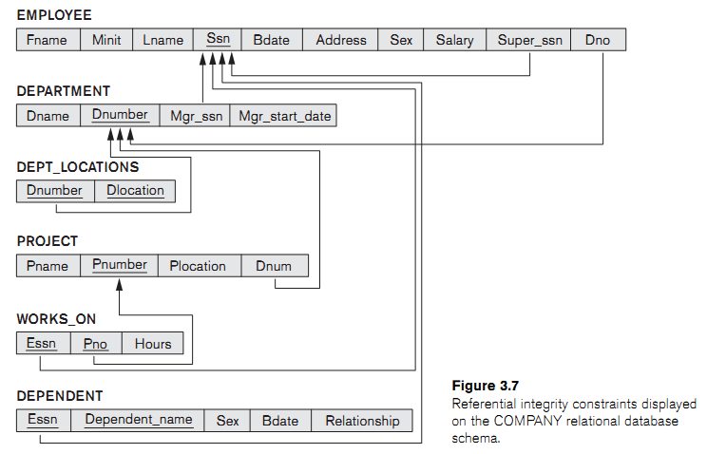
Slide 2 -<number>

Slide 29
Referential Integrity Constraint
Statement of the constraint
The value in the foreign key column (or columns) FK of the the referencing relation R₁ can be either:
(1) a value of an existing primary key value of the corresponding primary key PK in the referenced relation R_{2,}, or..
(2) a null.
In case (2), the FK in R₁ should not be a part of its own primary key.
Slide 2 -<number>

Slide 30
Other Types of Constraints
Semantic Integrity Constraints:
based on application semantics and cannot be expressed by the data model
E.g., “the max. no. of hours per employee for all projects he or she works on is 56 hrs per week”
SQL-99 allows triggers and ASSERTIONS to allow for some of these
Another type: Transition Contraints
Slide 2 -<number>

Slide 31
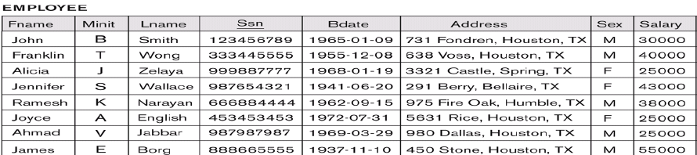
Slide 2 -<number>

Slide 32
Case study
Company Database
Slide 2 -<number>

Slide 33
Example COMPANY Database
Requirements of the Company (oversimplified for illustrative purposes)
  The company is organized into DEPARTMENTs. Each department has a name, number and an employee who manages the department. We keep track of the start date of the department manager.
  Each department controls a number of PROJECTs. Each project has a name, number and is located at a single location.
Slide 2 -<number>

Slide 34
Example COMPANY Database
  We store each EMPLOYEE’s social security number, address, salary, sex, and birthdate. Each employee works for one department but may work on several projects. We keep track of the number of hours per week that an employee currently works on each project. We also keep track of the direct supervisor of each employee.
  Each employee may have a number of DEPENDENTs. For each dependent, we keep track of their name, sex, birthdate, and relationship to employee.
Slide 2 -<number>

Slide 35
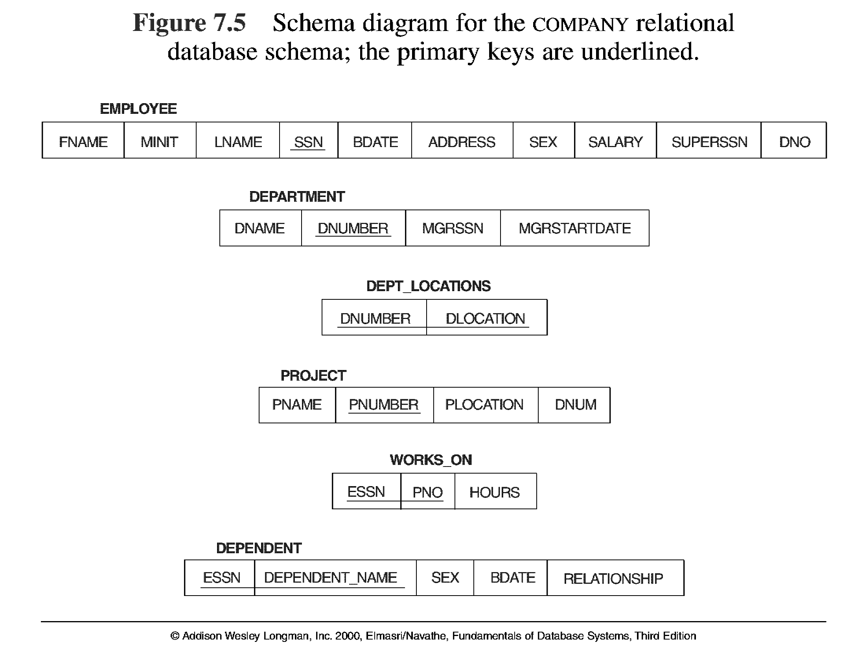
Slide 2-<number>

Slide 36
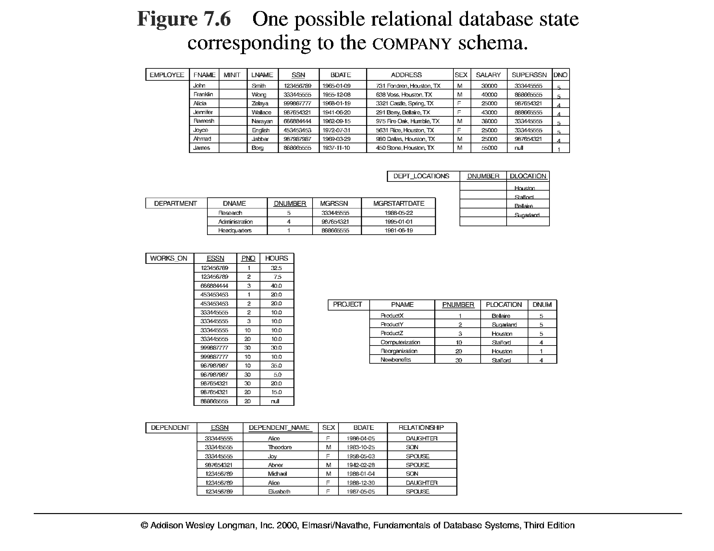
Slide 2-<number>

Slide 37
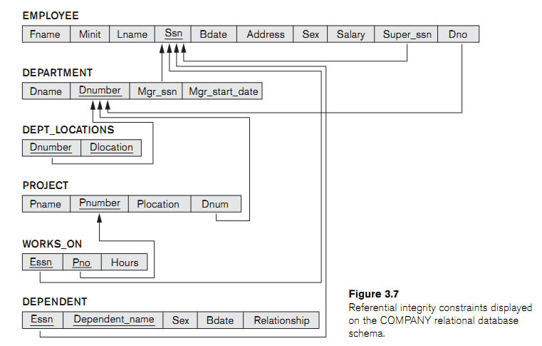
5.7
Slide 2-<number>

Slide 38
Update Operations on Relations
INSERT a tuple.
DELETE a tuple.
MODIFY a tuple.
Integrity constraints should not be violated by the update operations.
Several update operations may have to be grouped together.
Updates may propagate to cause other updates automatically. This may be necessary to maintain integrity constraints.
Slide 2 -<number>

Slide 39
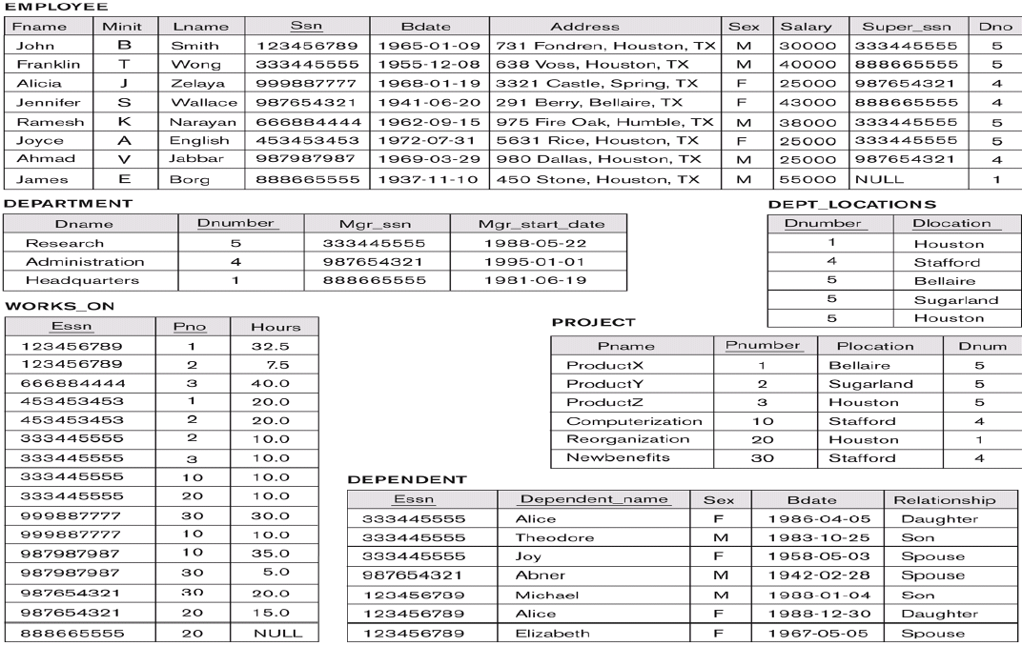
Slide 2-<number>

Slide 40
Examples:
Slide 2 -<number>

Slide 41
Update Operations on Relations
In case of integrity violation, several actions can be taken:
  Cancel the operation that causes the violation (REJECT or RESTRICT option)
  Perform the operation but inform the user of the violation
  Trigger additional updates so the violation is corrected (CASCADE option, SET NULL option)
  Execute a user-specified error-correction routine
Slide 2 -<number>

Slide 42
In-Class Exercise
(Taken from Exercise 5.15)
Consider the following relations for a database that keeps track of student enrollment in courses and the books adopted for each course:
STUDENT(SSN, Name, Major, Bdate)
COURSE(Course#, Cname, Dept)
ENROLL(SSN, Course#, Quarter, Grade)
BOOK_ADOPTION(Course#, Quarter, Book_ISBN)
TEXT(Book_ISBN, Book_Title, Publisher, Author)
Draw a relational schema diagram specifying the foreign keys for this schema.
Slide 2-<number>

Slide 43
Slide 2-<number>

Slide 44
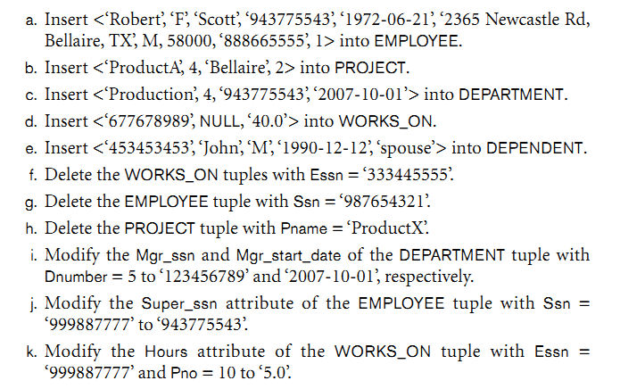
Discuss all integrity contraints violated by each following operation
Slide 2-<number>

